Slide 1
Mortgage Insurance
April 2016

Slide 2
DEFINITIONS AND KEY CONCEPTS
Mortgage Insurance (MI)
Mortgage lenders protect themselves against default-related losses by requiring mortgage insurance for loans with LTVs above 80%. There are two main providers of mortgage insurance in the U.S.: the government (FHA/VA/RHS) and private mortgage insurance companies.
The most prevalent form of mortgage insurance is flow insurance – insurance available on a loan-by-loan basis at origination.
Other forms of insurance include bulk insurance, pool insurance, and reinsurance.
Generally required for any single-family residential mortgage loan with a loan-to-value (LTV) ratio greater than 80%. By charter, Fannie Mae and Freddie Mac are not allowed to purchase residential mortgages with LTVs over 80% without credit enhancement. Bank regulations require credit support for mortgages on 1-4 family residential properties with LTVs equal to greater than 90%. MI is generally not available for loans with LTVs > 100%.
Key Providers
Federal Housing Administration (FHA): Government-backed program. Insures loans originated to borrowers who can afford to make only minimal down payments and/or have issues with credit.
Veteran’s Affairs (VA): Government-backed program. Insures loans originated to homeowners who served or are serving in the Armed Forces.
Private Mortgage Insurers (PMIs): Privately-owned companies that provide mortgage insurance in various forms including on a loan-by-loan basis, in bulk, and at the pool-level. PMIs also provide reinsurance.

Slide 3
DELIVERY CHANNELS FOR MI
There are multiple delivery channels for MI. The government is only involved in the flow channel; the private industry operates in all channels.
Primary Mortgage Insurance
Flow: Loans insured one at a time; premiums based on filed rate sheets
Bulk: Many loans insured at the same time. Each loan is priced separately with final rates set through a bidding process.
Pool Mortgage Insurance
Many loans insured through a single pool policy. Rates determined through a bidding process. All loans have the same premium rate.
Commonly have aggregate deductibles and stop loss thresholds
Reinsurance
The primary insurer transfers (cedes) a portion of the periodic insurance premium to the reinsurer in return for the reinsurer’s commitment to share losses. In some cases, the reinsurer also pays an upfront fee to the primary insurer.
Losses are shared on a pro-rata (quota share) or above a certain threshold (excess of loss).
Most private mortgage reinsurance is written by captive reinsurers affiliated with the lender.
Motivation for reinsurance is regulatory capital requirements.
Primary insurer remains liable for all coverage if the reinsurer fails to pay.

Slide 4
THE MORTGAGE INSURANCE BUSINESS: KEY ASPECTS
Key terms:
NOD (Notice of Delinquency): Servicer must notify insurer that an insured loan is in arrears. A NOD does not necessarily equate to a claim.
Cure: A NOD that is rectified without a mortgage insurance claim.
NIW (New insurance written): Balance on new policies written
Risk: Coverage $ on insured loans
 | Comments
Capital Intensive | Need $3 of capital to write $1 of premium. Ratios have increased recently.
Indefinite Policy Terms | Policy term is unknown at the time the loan is originated and averages 5-6 years (the typical WAL for 30-year loans).
Contagion | At times of economic distress, risks of mortgage default become highly correlated as many borrowers are simultaneously impacted.
Small claim sizes | A typical claim size is $50K and a $200K claim is rare. Losses are driven by frequency.
Loss emergence is not uniform | The likelihood of defaulting can vary significantly over the life of the policy.
Short-tailed reserving | Most delinquent loans are resolved within 12 to 18 months (Delinquency resolutions were much slower in the Housing Crisis of 2007-2009 and its aftermath).

Slide 5
THE IMPORTANCE OF MI FROM THE VANTAGE POINT OF PREPAYMENT RISK
Given the statutory requirements of the GSEs and the housing policy objectives of the FHA and VA insurance programs, MI plays an integral role in the U.S. Housing Finance System.
In particular, changes in the availability and level of MI affect homeowner prepayment rates and thus impact the pricing of MBS.
Key Connections Between MI and Prepayments
Availability of MI: MI availability plays a key role in High LTV (LTVs > 80%) lending. The entry or exit of MI providers can have a profound impact on the ability of High LTV borrowers to refinance their loans.
Changes in MI Underwriting Standards: This is an extension to the first point. Opening up/closing the underwriting box, changing the relative pricing of collateral characteristics in the underwriting matrix, and changing the overall level of MI premiums significantly influences which subsets of High LTV borrowers can refinance.
Cross-Sector Refinances: For LTVs between 90-97%, the government and private MI programs can be regarded as competitors for the same pool of High LTV borrowers. Changes in pricing by one program can thus affect the refinancing behavior of borrowers in both programs.

Slide 6
COMPARING GOVERNMENT AND PRIVATE MI PROGRAMS
Factor | Private Mortgage Insurance | Government Programs
Minimum down payment | Typically 3%. | 3.5% on FHA-insured mortgages. In most cases VA does not require a down payment.
Loan coverage level | Varies | FHA insures the entire loan balance; VA guarantees a percentage of the loan.
Limit on size of the mortgage insured or guaranteed | None | Beginning in 2009, the loan limit for FHA-insured mortgages for one-unit properties is 115 percent of the local area median home price, as determined by HUD, with a floor of 65 percent of the conforming loan limit (or $271,050) and a ceiling equal to 150 percent of the conforming limit . Limits vary by geographic region and for 2 - 4 unit properties. The VA’s loan limits are the same as conforming loan limits.
Up-front mortgage insurance premium (UFMIP) | Generally not required | 1.75% UFMIP Required by FHA; VA requires an up-front funding fee.
Monthly premium | Premiums vary based on the size of the down payment, type of mortgage, and amount of insurance coverage. | FHA borrowers pay an annual insurance premium that starts at 0.85% percent of the loan balance and declines over time. There is no insurance premium for VA mortgages.
Cancellation of insurance | Can usually be canceled when the homeowner acquires 20 percent equity in the home. Under Federal law, MI must be cancelled automatically when the borrower has paid the loan down to 78 percent of the original home value. | For FHA mortgages with terms greater than 15 years, the annual mortgage insurance cancels when the LTV ratio reaches 78 percent, provided the borrower has paid the annual mortgage insurance premiums for at least 5 years and that the loan was closed after December 31, 2000 and had a case number assignment before June 3rd, 2013.
Deductibility of borrower-paid mortgage insurance | Yes, up to a certain income level, through the 2016 tax year. | Yes, up to a certain income level, through the 2016 tax year.
Income limits | None | No maximum income limit on FHA/VA loans.
Interest rate | Market driven | Market driven
Regulation | State regulated. Regulation extends to reserves for losses, capital, etc. | FHA and VA mortgage programs are administered by agencies of the U.S. government.
Source: Cello, FHFA.

Slide 7
HOW PRIVATE MORTGAGE INSURANCE WORKS: COVERAGE
A PMI covers only a specified portion of the loss. This percentage is called the coverage percentage and is typically between 12% to 35% of the gross claim amount.
The gross claim amount consists of the outstanding principal, accrued interest, and various expenses incurred during the foreclosure process.
PMI coverage lowers the LTV of the loan from the perspective of the holder of the credit risk on the loan.
Effective LTV =
1 – Equity –
(Coverage * LTV)
Purchase
Price
Purchase
Price
Loan Amount
(90% LTV)
Loan Amount
(90% LTV)
Lower coverage =
Higher exposure
Higher coverage =
Lower exposure

Slide 8
HOW PRIVATE MORTGAGE INSURANCE WORKS: COVERAGE LEVELS DEPEND ON INIITIAL LTV
Most originators use the loss coverage scheme developed by Fannie Mae and Freddie Mac.
Coverage | UNDERWRITTEN LTV RANGE |  | EFFECTIVE LTV RANGE
35% | >= 95.01 | <= 100 | 61.8>= | 65%
30% | 90.01 | 95 | 58.5 | 61.8
25% | 85.01 | 90 | 55.3 | 58.5
12% | 80 | 85 | 52.0 | 55.3
Source: Cello analysis of Agency MBS data.

Slide 9
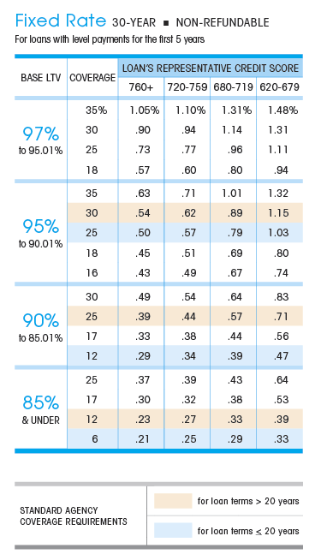
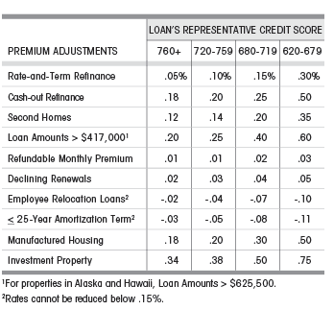
HOW PRIVATE MORTGAGE INSURANCE WORKS: SAMPLE RATE SHEET
The MI premium is expressed as an annual percentage of the loan balance.
MI premiums may be incorporated into the borrower’s monthly payment or paid separately.
Rates cannot change over the life of the policy and the policy cannot be cancelled by the insurer except for non-payment of premiums.
Source: MGIC (as of May 2014).

Slide 10
HOW PRIVATE MORTGAGE INSURANCE WORKS: CALCULATING CLAIM AMOUNTS
If a borrower defaults on an insured loan and the lender forecloses and takes title to the property, there will be an insurance claim.
The MI usually has the option to pay the entire loan balance and expenses to the lender and take title to the property or to let the lender retain the title and pay the lesser of:
Actual losses plus expenses
The coverage amount.
Statutory disbursements = statutory expenses related to the foreclosure process such as sale publications, title costs, filing fees, deed recordings, or sheriff’s expenses for conducting the sale.
Original Loan Balance, LTV, Coverage | $90,000, 90% LTV, 25% Coverage
Principal Balance Due at Default | $88,915
Accumulated Interest | 7,850
Subtotal | $96,765
Expenses
Attorney’s Fees | $1,000
Property Taxes | 1,140
Hazard Insurance | 710
Property Preservation | 350
Statutory Disbursements | $1,500
Subtotal | $101,465
Less Escrow Balance | ($240)
Total Possible Claim | $101,225
Times Coverage Purchase (25%) | × .25
Total Optional Claim Payment | $25,306

Slide 11
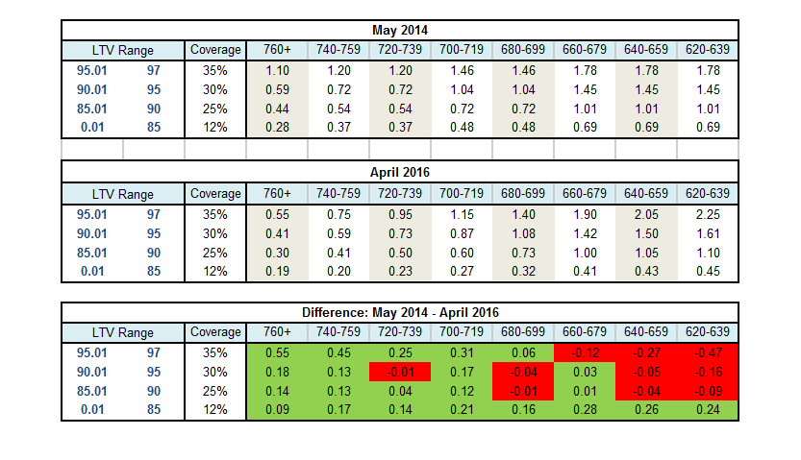
THE EVOLUTION OF MI PREMIUMS: PRIVATE MI
Over time, PMI premiums for higher credit borrowers (as captured by the FICO score) have decreased, whereas those for lower credit borrowers have increased.
These changes are partly in response to the new set of standards rolled out by the GSEs and FHFA to ensure that the MIs are strong counterparties to the GSEs.
These standards are known are Private Mortgage Insurance Eligibility Requirements (PMIERs). In addition to creating a set of operational standards for MIs, PMIERs establishes capital requirements based on the performance of mortgage loans in a stress test.
Source: Cello analysis of MGIC data.

Slide 12
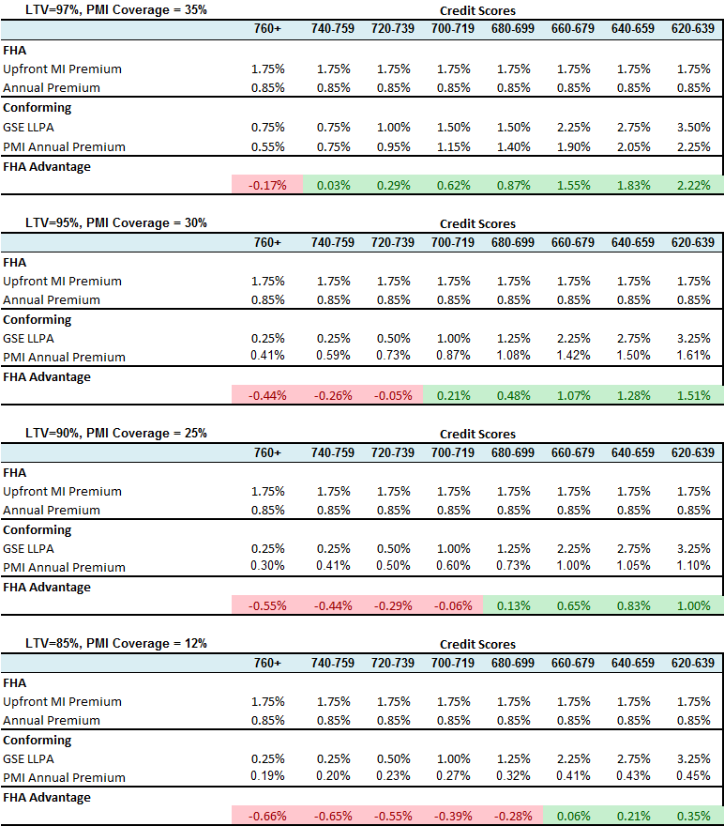
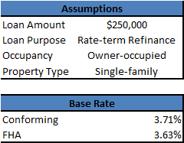
MI PREMIUMS: COMPARING PRIVATE AND GOVERNMENT MI
The PMI and FHA programs are mostly competitive in the 90-97% LTV range. The PMI programs are more targeted towards higher FICO scores.
Assumptions:
1% LLPA = 25bps in yield
1% UFMIP = 8bps in yield (because the UFMIP can be rolled into the loan balance)
Source: Cello, FHA, Fannie Mae, MGIC.

Slide 13
THE GOVERNMENT’S SHARE OF THE MI MARKET HAS VARIED SIGNIFICANTLY OVER TIME
The PMI share of Primary MI was very high prior to the Housing Crisis of 2007-2009 as a significant number of borrowers migrated away from the FHA program to private-label sectors such as Alt-A and Subprime.
Over 2007-2009, the collapse of the housing markets and the ensuing wave of defaults led to a significant pullback from private mortgage insurers and a correspondingly large increase in the FHA’s market share.
Since 2009, there has been a gradual increase in PMI share and a steady decrease in FHA share as private mortgage insurers have been gradually restored to health.
In 2015, FHA’s declining market share was reversed by a cut in its mortgage insurance premiums.
NEW PRIMARY MORTGAGE INSURANCE MARKET SHARE
(2004-2015)
Net IO% vs OAS
(June 2011 to October 2014)
Source: Inside Mortgage Finance.

Slide 14
PRIVATE & GOVERNMENT MI MOSTLY COMPETES IN THE 90-97% LTV RANGE
The PMIs and the FHA compete for the same borrowers in the 90-97% LTV range.
Changes in the pricing of one program can thus have an impact on the prepayment rates of both programs.
FHA SHARE OF HIGH LTV REFINANCINGS
(January 2013 – January 2016)
FHA MIP Rate Cut
Conventional High LTV loans: All newly originated refinanced loans with LTVs >80% across all FNMA/FHLMC 30-year pool types (CL, CQ, U6, U9 etc.)
FHA: All newly originated 30-year FHA Refinance loans.
Source: Cello

Slide 15
SNAPSHOT OF THE CURRENT PMI INDUSTRY
There are currently 7 active providers of MI in the U.S.
Although there are significant gaps in the availability of historical MI pricing across private mortgage insurers, it is relatively straightforward to get a sense for current pricing.
Corporation | 2015 Primary Market Share* | URL | Comments
United Guaranty | 24% | https://www.ugcorp.com/ | Fill in web form to obtain quotes
Mortgage Guaranty Insurance Corp | 20 | https://www.mgic.com/rates/rate-cards.html | Resource for historical MI levels
Radian Guaranty Inc. | 19 | http://www.radian.biz/page?name=RatesAndGuidelinesNew | “BPMI Prime Rates”
Genworth Financial | 15 | https://mortgageinsurance.genworth.com/RatesAndGuidelines/RateCards.aspx | “Monthly Premium MI”
Esssent Guaranty | 12 | https://www.essent.us/rates-guidelines | “Borrower-Paid Mortgage Insurance Monthly”
National MI | 6 | http://www.nationalmi.com/products-rates/
Arch Mortgage Insurance | 5 | https://mi.archcapgroup.com/Rates/Rate-Sheets
Source: Cello, Inside Mortgage Finance. As of 3/15/2016. Traditional primary MI does not include bulk, pool or HARP activity.

Slide 16
DISCLOSURES Important Notes
THIS DOCUMENT IS NOT AN OFFER TO SELL OR THE SOLICITATION OF AN OFFER TO BUY SHARES OF THE FUND. AN OFFERING OF INTERESTS WILL BE MADE ONLY BY MEANS OF A CONFIDENTIAL PRIVATE PLACEMENT MEMORANDUM AND ONLY TO QUALIFIED INVESTORS IN JURISDICTIONS WHERE PERMITTED BY LAW. PAST PERFORMANCE IS NO GUARANTEE OF FUTURE PERFORMANCE.
An investment in the Fund is speculative and involves a high degree of risk. The Fund will have substantial limitations on investors’ ability to redeem or transfer their shares, and no secondary market for the Fund’s shares exists or will develop. All of these risks, and other important risks, are described in detail in the Fund’s Confidential Private Placement Memorandum. Prospective investors are strongly urged to review this Confidential Private Placement Memorandum carefully and consult with their own financial, legal and tax advisors, before investing.
Portions of this document may contain commentary and/or data based on certain current assumptions by Cello Capital Management, LP(“Cello”), which are subject to change at any time, as well as Cello's internal complex calculations. If one or more of these assumptions or calculations is incorrect, the information contained herein may unintentionally be inaccurate.
Certain information contained herein may have been obtained by Cello from third parties. While Cello believes such sources are reliable, Cello has not verified the accuracy of such information and shall not be liable for any errors in such information or for any actions taken in reliance thereon.
Performance results referenced in this document are provided for an investor in Class A1a shares of Cello Fixed Income Master Fund, LP (the “Master Fund”). Unless otherwise noted. Performance reflects all income. Class A1a shares launched on January 1, 2012, and returns for periods prior thereto have been adjusted to reflect the management fees and performance allocations chargeable to Class A1a shares.
The Credit Suisse Fixed Income Arbitrage Hedge Fund Index is a subset of the Credit Suisse Hedge Fund Index that measures the aggregate performance of fixed income arbitrage funds. The Fixed Income Arb Index, which includes mortgage-backed securities, is part of Dow Jones Credit Suisse Hedge Fund Index. The Barclays U.S. Aggregate Index represents securities that are SEC-registered, taxable, and dollar denominated. The index covers the U.S. investment grade fixed rate bond market, with index components for government and corporate securities, mortgage pass-through securities, and asset-backed securities. The Credit Suisse All Hedge Index is an asset-weighted hedge fund index. The S&P 500 is an equity index based on the market capitalizations of 500 large US companies.
This document may also contain certain forward looking statements and projections. Such statements and projections are subject to a number of assumptions, risks and uncertainties which may cause actual results, performance or achievements to be materially different from future results, performance or achievements expressed or implied by these forward-looking statements and projections. Prospective investors are cautioned not to invest based on these forward-looking statements and projections.
This document may contain references to certain internal Cello procedures and policies which are subject to change at any time.
No information or material contained herein may be reproduced, transmitted, displayed or commercially exploited without the prior written consent of Cello. All rights are reserved.

